Slide 1

ELECTROMAGNETIC FIELDS AND WAVES
COURSE PROJECT
NAME: S YALAGURESH FACULTY :AKASH KULKARNI
USN: 01FE20BEC086
ROLL NO:236

Slide 2
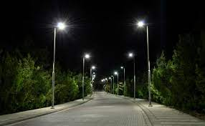
AUTOMATIC STREET LIGHT

Slide 3
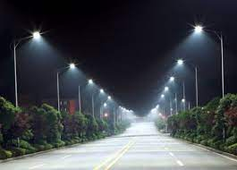
CONTENTS
INTRODUCTION
HOW IT WORKS MAIN COMPONENTS
CIRCUIT
PROTEUS SIMULATION
ADVANTAGES
APPLICATION
CONCUSION

Slide 4
INTRODUCTION
-LDR IS VERY USEFUL IN LIGHT/DARK SENSOR
-REDUCING THE WASTAGE OF POWER
-CIRCUIT NORMALLY THE RESISTANCE OF AN LDR IS VERY HIGH SOMETHING AS HIGH AS 100000 OHMS

Slide 5
HOW IT WORKS
IT SHOULD LIGHTS ON WHEN THERE IS NO
LIGHT, MEANS NO SUNLIGHT.
WHEN LIGHT COMES,IT SHOULD TURN OFF.
WHEN LIGHT COMES WITH PARTICULAR
INTENSITY, STREET LIGHT TURNED OFF.

Slide 6
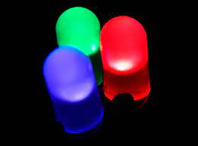
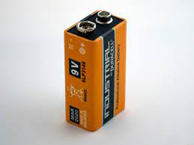
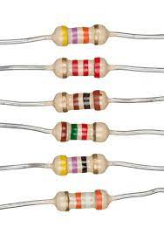
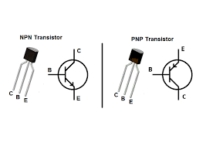
MAIN COMPONENTS
TRANSISTOR BC547
LDR
RESISTOR
LED
BATTERY

Slide 7
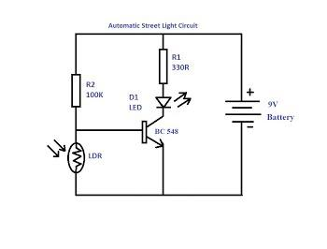
CIRCUIT

Slide 8
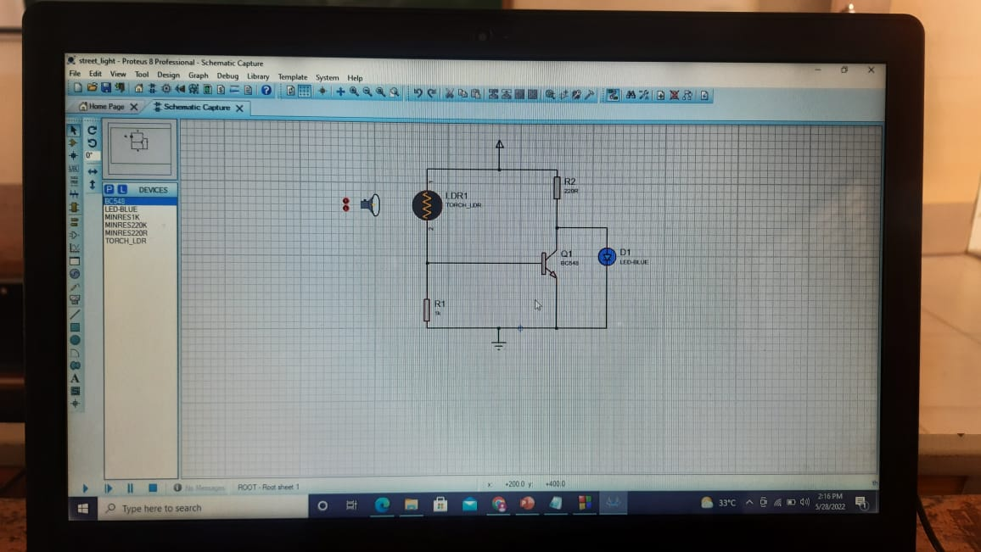

Slide 9
ADVANTAGES
ENERGY SAVING
LOWCOST
SAFETY AND SECURITY
AUTOMATED OPERATION

Slide 10
APPLICATION
USED IN STREET LIGHT APPLICATIONS
USED IN DOMESTIC APPLICATIONS

Slide 11
THANK YOU

